Slide 1
Normalization:
Context and Prospects
Mauricio Font
Director, Bildner Center
for Western Hemisphere Studies
The Graduate Center, City University of New York
www.bildner.org
FLACSO-Santiago, January 21, 2015

Slide 2
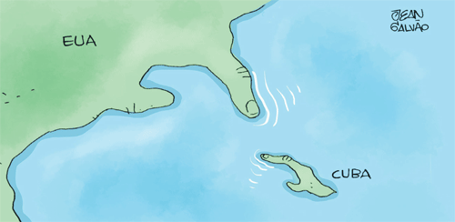

Slide 3
The Big Surprise of December 17, 2014
President Barack Obama in Washington and Raúl Castro in Havana announced an agreement to normalize relations.
NYT: Agreement reflects 18 months of secret talks, after Obama’s reelection. Two WH assistants to President Obama, Benjamin Rhodes and Ricardo Zuñiga, conducted 9 meetings with ‘Cuban counterparts starting in June 2013, most of them in Canada. At least one of the meetings, in October to complete the deal, took place in the Vatican/Pope Francis. Finally, 45 minute conversation between Obama-Castro just before 12/17/2014. [This account came from Peter Baker’s “US to Restore Full Relations with Cuba, Easing a Last Trace of Cold War Hostility” NYT 12/17/2014; NYT’s editorials favoring lifting of embargo.]

Slide 4
Historic Agreement
It is perceived as such by other international actors and the media.
Will shape process of reform (actualización) in Cuba.
“Normalization” is in itself a sea change in US policy toward Cuba.
It aims at the eventual lifting of the embargo.
Still, many questions …

Slide 5
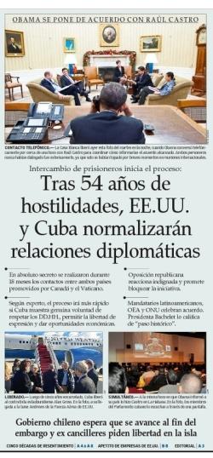


U.S. to Restore Full Relations With Cuba, Erasing a Last Trace of Cold War Hostility
By Peter Baker DEC. 17, 2014
Notes:
NYT: Agreement reflects 18 months of secret talks, after Obama’s reelection. Two WH assistants to President Obama, Benjamin Rhodes and Ricardo Zuñiga, conducted 9 meetings with ‘Cuban counterparts starting in June 2013, most of them in Canada. At least one of the meetings, in October to complete the deal, took place in the Vatican/Pope Francis. Finally, 45 minute conversation between Obama-Castro just before 12/17. [This account came from Peter Baker’s “US to Restore Full Relations with Cuba, Easing a Last Trace of Cold War Hostility” NYT 12/17/2014; NYT’s editorials favoring lifting of embargo.]

Slide 6
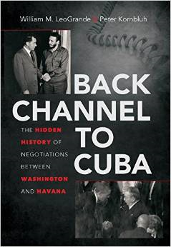
Not the First Attempt at Normalization
Several US presidents attempted this in the 1970s and 1990s. They were all aborted in large part by actions by Cuba.
W. LeoGrande & P. Kornbluh Back Channel to Cuba: The Hidden History of Negotiations between Washington and Havana.

Slide 7
The Embargo
President Dwight D. Eisenhower (1/20 1953 to 1/20 1961) imposed the first trade embargo in 1960 and broke off diplomatic relations in January 1961.
John Kennedy (1/20 1961 to 11/22 1963): April 1961 Bay of Pigs invasion to overthrow Castro, followed by missile crisis in October 1962. Cuba in the middle of the Cold War.
Post-1963 Cold War containment (diplomatic and political isolation, economic restrictions, propaganda).
Cuba survived not only the fall of Soviet-style socialism after its collapse in 1989, but also the hardening of the embargo in 1991 (Torricelli bill) and 1996 (Helms-Burton).

Slide 8
Fast-Forward to 2006-2008
Fidel Castro becomes ill.
New president Raúl Castro launches Reform Process.
Barack Obama favors conversation & engagement since 2008.
In 2013 Obama authorizes high-level conversations, designating WH aides Benjamin Rhodes and Ricardo Zuniga for the task.
Nine meetings with Cuban counterparts start in June 2013 (most of them in Canada) (NYT 12/17/2014).
Pope Francis encourages talks and hosts a final meeting in October 2014.
On Dec 16, 2014 Obama speaks with Castro for 45 minutes.

Slide 9
Terms of Agreement
Prisoner Exchange:
► US releases 3 Cubans in jail since 1998
► Cuba releases A Gross in jail since 2009 & R Sarraff (a
Cuban working for US intelligence in jail for 20 years)
► Cuba promises to release 53 activists
US to ease restrictions on remittances from $500 to $2,000 per month, Internet access …
US to ease travel restrictions to Cuba
Cuba to be removed from the list of sponsors of terrorism
A new “honest and serious” debate to lift the embargo to begin
Notes:
12 travel categories: family visits, official visits, journalistic, professional, educational and religious activities, and public performances

Slide 10
Normalization after 12/17/2014:
Larger role for State Department: Assistant Secretary Roberta Jacobson for Western Hemisphere to go to Havana for talks about migration and normalization
Other high-level visits possible: Commerce Secretary Penny Pritzer may lead a commercial mission; Secretary of State John Kerry?
Meetings/conversations
Amb. Jeffrey DeLaurentis, current Representative/USIN, probably to become the first chargé d’affaires, pending confirmation of ambassador.

Slide 11
US Implementation: Fast & Bold
1/15/2015 Announcement
Following Cuba’s release of 53 political prisoners:
US implementation policies to go into effect next day: Friday, 1/16/2015
Travel (easing restrictions, as per the agreement of 12/17/2014), plus talk of regular air service by US companies; many Americans can travel without a specific license, as before), can use credit/debit cards, no limited per diem, $400 worth of goods to US
Remittances (4x, as in agreement)
Financial measures (finance small projects; open some accounts)
Trade (some relaxation: construction equipment; computers & communications equipment/services; software; 6-month rule for ships
New rules in Treasury department’s revised list of sanctions
But full use depends on Cuba’s own decisions

Slide 12
US Implementation: State of the Union Message of 1/20/2015
Obama: US Congress should end embargo
Rep. Carlos Curbelo (Republican, Florida) response in Spanish
Guests: Rosa Maria Paya, Antunez and wife, other dissidents

Slide 13
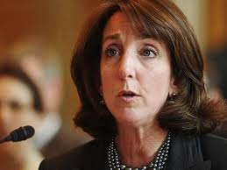
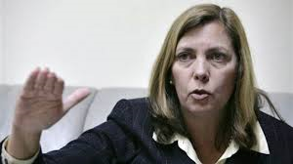
US-Cuba Havana Talks
Jan 21 and Jan 22, 2015
R Jacobson
J Vidal
US team led by Western Hemisphere Assistant Secretary Roberta Jacobson. Cuba´s team led by Josefina Vidal (Director of US affairs at Minrex)
Wednesday 1/21/2015: Migration talks (started in the 1990s, suspended under GH Bush, resumed by Obama in 2009 [Alex Lee] suspended again after Alan Gross, and restarted in 2014. According to Minrex, agenda includes opening of embassies and related. US side: Alex Lee.
Thursday 1/22/2015: Normalization …

Slide 14
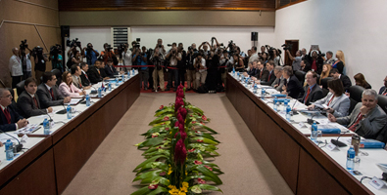
US-Cuba Havana Talks
Jan 21 Opening
R Jacobson
J Vidal

Slide 15
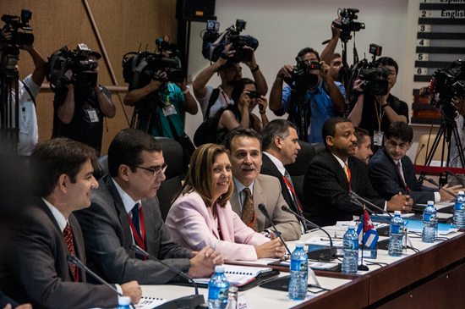
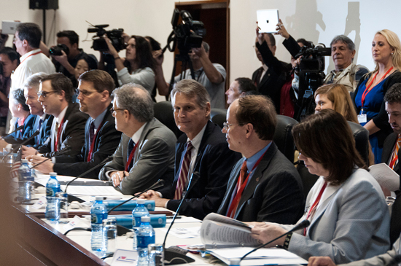
US-Cuba Havana Talks
Jan 21 Opening

Slide 16
Enduring Issues
Previous normalization efforts failed due to differences over political and economic issues:
US demands:
Human Rights and respect for political dissidents
Democratic reforms
Compensation to U.S. property holders for the confiscation of more than $1 billion worth of U.S. property in early 1960s.
Cuba demands the lifting of the embargo and acceptance of Cuba’s economic/political model (…sovereignty, international policy)

Slide 17
Context

Slide 18
Context: U.S
  President Obama: convictions and interests
  US role in global affairs (rise of Asia/China, Middle East focus, Russia), AND recent economic recovery
  Neglect of LAC: China’s role, regionalism (Mercosur, ALBA, Celac …)
  Failures of past Summits of Americas and new trade initiatives (Trans-Pacific Partnership (TPP) … & Transatlantic Trade and Investment Partnership (TTIP, US-Europe)

Slide 19
Embargo: Shifting Winds
International opposition to embargo
Region: Latin America Caribbean of particular interest
Three reasons: dislike for hegemonic imposition; sympathy for the present Cuban regime; Cuban diplomacy
Support of Catholic Church
China, Russia

Slide 20
In the U.S….
Increasing Support
Public opinion (more than 60 %) plus a shift from younger Cuban-Americans and significant numbers of Cuban-Americans
Catholic Church, US Chamber of Commerce and Human Rights Watch
Major agricultural interests/business
Democratic senators and governors (Leahy; New York’s Andrew Cuomo) ... Trade & business Republicans
Opposition in the US: Many Republicans, including 2 in the “Cuba Caucus” in the US Senate: Marco Rubio (UMiami Law); Ted Cruz (Texas, another Harvard Law graduate; Princeton BA in political science); plus Democrat Robert Menendez (New Jersey, Rutgers Law School). These 3 Cuban-Americans share very American family narratives: born to Cuban migrants (of the 1950s) becoming very successful political careers. Articulate, skillful, mainstreamers … Remarkable: 3/100 senators; 3 of 50 states… plus 5 representatives

Slide 21
Cuba Model:
Reform and Performance
OBSTACLES
Cuban economy growing very slowly--1.3 % in 2014. Projections of 4% for 2015 rather optimistic in the light of Venezuela’s crisis, the low price of oil and other commodities, and the ill-fated search for oil.
Resistance and insufficient reforms (lingering attachment to statist model and policies that have not worked); structural (e.g., demographic) obstacles.
Generational: Fidel is 88 and not well; 83, Raul stated that he would pass on the presidency in 2018. Other main leaders in the same age group: Machado Ventura, Ramiro Valdes, others …

Slide 22
Prospects

Slide 23
Crafting a New Chapter
Against that background, the Normalization Agreement: Turns the Page in US-Cuba relations. Indeed, this means the writing of a new chapter.
Still, the writing of the new chapter and the full implementation of the basic agreement needs to move fast to endure and lead to deeper shift in US-Cuba relations. WHY?
Political Timetables: Obama as well as Raul face challenges in 2015 and 2016 challenges.
Resistance in the US has the potential for expanding fast: Normalization is emerging as a significant issue in the political dynamics preceding the 2016 presidential election.
The U.S. wants to create conditions for improved inter-American relations, including a successful Summit of the Americas (Panama, April 2015) and negotiations with South America on Pacific trade agreements. Diplomacy and cooperation (coalition-building)
Cuban authorities need action and results before the 7th Congress of the Communist Party of Cuba (April 2016) – five years after the 6th Congress and the Lineamientos.

Slide 24
Differences and Perils
Raúl Castro mentioned differences over issues of human rights/democracy, national sovereignty, international policy. He left out internal differences over the main issue in the mind of Cubans: the gradually expanding internal debate over economic development model
The new chapter centers on resolution, even if partial, of the lingering debate between reformers and statists: Statism or market?
Normalization and changing relations with the US provide a key context for the dependent island: Remittances, tourism, investment and innovation, trade/markets …
The challenge is how to reconcile these different views: within and outside Cuba.
Complete normalization likely to be a long and difficult process.
How to address these differences within US and transnational Cuban society.

Slide 25
Remittances
Cash remittances allowed after 1993 (dollar allowed)
$2.6 billion in 2012 (growing at 13.5% / year)
$2.5 billion in kind (packages & luggage) ( $2.7 to 3.5 in 2013, at least 6.6 growth)
Total remittances: $5.105 billion in 2012 (and higher since then, Western Union expanded service in 2014)
Remittances represent MORE than tourism ($2.6b), nickel ($1.4b), pharma ($500 million, sugar (391 million) COMBINED (2012 figures)
E.g., Cubans abroad finance 70% of Cuban cellular service /Internet access (cybercafes charging $5/hour)
Data from Emilio Morales, The Havana Consulting Group

Slide 26
Tourism
Periodo Especial led to new focus on international tourism
Havana, Varadero, other FDI into hotels/resorts
Recent travel to Cuba from US: 500,000 plus, 80% from Cuban-Americans.
Total tourists: about 2.5 to 3 million per year.
Notes:
Pluls

Slide 27
Cuban-Americans
More than 2 million Cuban-Americans (1.1 million born in Cuba) in the US--up from 1.2 million in 2002.
More than 500,000 new arivals since 1999. In 2013, more than half of Cuban immigrants had arrived since 1990.
Early waves have done well (higher average income than non-Hispanic whites)
7 out of 10 Cuban-Americans live in Florida
Political views:
Republican: from 64% in 2002 to 47% in 2013
Democrat: from 22% in 2002 to 44% in 2013
2012 presidential vote: 49% Obama vs. 47 % Romney
Source: PEW

Slide 28
U.S. Agenda:
Refocus on Region (a challenge)
Brazil as Intermediary?
Improve relations with new Brazilian government and cooperate. VP Biden to visit Brazil. Visit to US by Brazilian head of state.
Brazil’s new presence in Cuba: Mariel, sugar sector, exports, investment.
Mexico
Chile’s role?

Slide 29
Two Main Pathways to Market Economy
  .
  Dual Transformation (Soviet Union & CEE)
    Rapid political and economic changes (almost overnight)
    ‘Big Bang’ or ‘Shock Therapy’
    Radical market liberalization & decentralization
    Opening up the market for foreign competition
    Price liberalization
    Mass privatization
  Gradual Transformation (Sino-Vietnamese model)
      Gradual economic liberalization and decentralization (role of local authorities)
      Strong (political) state control
      No mass privatization

Slide 30
Problems With “Shock Therapy”
  Without ‘bottom-up’ entrepreneurial social forces a system collapse may result transformation crisis and ‘oligarchic capitalism’ (e.g. Russia, Ukraine). The crisis was shorter in Hungary & Poland because entrepreneurial history during communism.
  Fast Liberalization. Real entrepreneurs serve as ‘buffers’. Opening to foreign competition may be fatal for the local economic actors not ready to the strong competition (e.g. Cuban agriculture, restaurant sector).
  Mass Privatization. Some findings suggest mass privatization may have serious negative impacts on economic performance. Fast and broad privatization → Hotbed of systemic grand corruption (e.g. new oligarchs in Russia & Ukraine).

Slide 31
A Gradual Sino-Vietnamese Model?
2 Issues...
  Workers in agriculture. With its very low level labor force in agriculture (20%), Cuba cannot easily follow the model of Asian agricultural growth.
  Workers in public sector. The huge dominance of public sector employment (74%) makes it hard for the emergence of a potential non-state sector. How to turn them into risk-taking entrepreneurs?

Slide 32
Restructuring the Public Sector:
Dangers
China, Vietnam (1970s) → Young rural population, few employed by the public sector, decentralized economy: rural liberalization (e.g. township & village enterprises ´´{TVEs, post-1978 reforms, privatization}).
Cuba (2014) → Centralized economy. Aging, urban public sector employees in a highly subsidized state-sector. Not motivated to change. Aging and possibly decreasing labor force.
Transforming skills to be fit for new environment requires: conscious strategy, resources, training, institutions, partnership
Shock therapy in CEE
  Massive de-industrialization eliminated most industrial and agricultural jobs.
  Public employees could not transform their skills to be fit for the new capitalist environment → Millions of unemployed & early retired people.

Slide 33
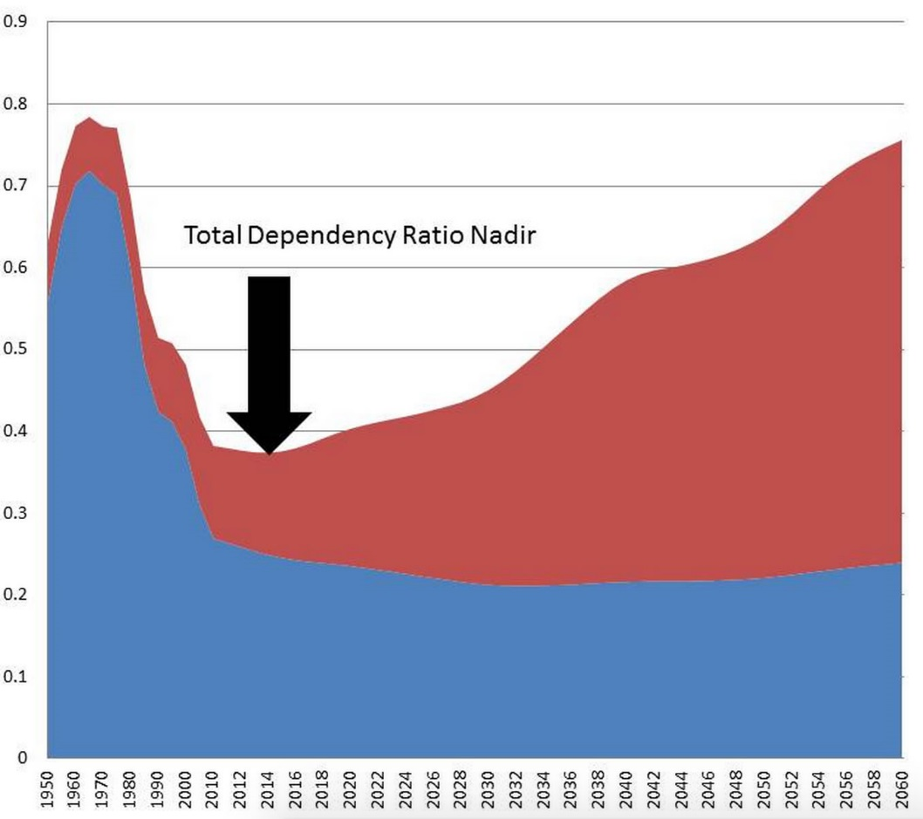
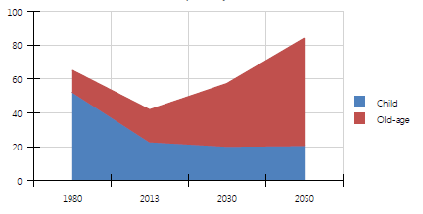
Structural Differences in Labor Force dependency ratio (% of working-age population)
China 1970s
Cuba now
Source: UN Population Division 2013

Slide 34
Outside Help and Investment in Entrepreneurship!
  Cuba needs economic actors to drive economic changes and buffer the impacts of possible “transformation shock” and crises.
  Incubators → Hubs for entrepreneurial activity. Technical assistance, training programs, partnership between schools and firms etc.
  Functioning private sector needs cheap labor. Negative example: Mariel Export Processing, heaviest labor tax in the world

Slide 35
Economic Integration
  Cuba’s geographic proximity to the US market is of a strategic advantage
  Cuba is better located than China, Vietnam or Russia to reintegrate into global markets!
  Rapid integration of Central Europe into the huge EU common market may offer some parallel.
  IMF, World Bank etc. → Grants, loans & training
  Meeting the world’s relevant standards for manufactured products and services.

Slide 36
Products to Export
Few additional products Cuba may export. The service sector and remittances make up mainly Cuba’s GDP.
Cuban economy → Low-productivity service economy where merchandise export counts less than 10% of the national output.
What to sell to the huge US market? biotechnology, health-care products, fruits/vegetables, cultural products (music), tourism & medical tourism, etc.

Slide 37
Near future will be decisive
Grounds to expect Normalization to meet key goals, but will take work and time.
Focus on reforms and economic development essential.
But what about Democracy and Human Rights?
Role of regional collaboration.

